Slide 1



@HealthierGen
/HealthierGeneration
Notes:
Pre-presentation slide:
WHAT: The intention of this presentation is to:
Introduce the Healthy Schools Program to your School Wellness Committee/Team
Inform stakeholders of the school’s participation in the healthy schools program;
Demonstrate how the healthy schools program 6-step process and framework of best practices guides schools towards achieving greater health in the school environment;
Highlight the wellness goals the school hopes to attain;
Encourage broad engagement throughout the school community.
WHEN: This presentation can be delivered any time one of the (above) objectives needs to be met; however, the beginning of the school year is an optimal time to inform and remind school stakeholders about Healthy Schools Program participation.
WHO: This presentation can be delivered to: school staff/administrators, district administrators, PTO/PTA, parents and community members.
HOW: There are some areas in which this presentation can be customized to fit the needs of the individual school. In advance of your presentation, please review slides and talking points and update to reflect (and appeal to) the specific audience to which you are presenting.
More promotional tools and resources can be found at healthiergeneration.org or by contacting our Member Engagement and Support Team: Member Engagement & Support Team | 888.KID.HLTH (888.543.4584)

Slide 2


[Our School]
and the Healthy Schools Program
Notes:
I would like to introduce you to a program [our school] is using to help us create a healthier school for our students and staff. The Healthy Schools Program is a proven, fun and effective way to integrate best practices for health and wellness through small, incremental changes to our school environment. They provide a process, support and resources to guide us– and the best part?...It’s at no cost!

Slide 3

Each day in our classrooms
we deal with:
Increased absences and tardiness
More student visits to nurses office
Discipline/ behavior issues
Food insecurity
Test scores
Healthy students learn better.
Notes:
This generation is dealing with many health issues. As (teachers, school staff members, administrators, parents), we see the results of this in our classrooms/schools each day – we are dealing with:
[Choose examples that fit your school]:
Increased absences and tardiness
More student visits to nurses office
Discipline/ behavior issues
Food insecurity
Test scores
The combination of childhood obesity and compromised mental wellness can negatively impact kids’ academic performance and overall life outcomes. If we work to address the health of our students, we’ll can see positive results in these other areas as well. This is all part of a Whole School, Whole Child, Whole Community approach.

Slide 4
HEALTHIER GENERATION
VISION
MISSION
All young people deserve a chance to
live healthier lives.
Healthier Generation works to empower kids
to develop lifelong healthy habits by ensuring the environments that surround them provide and promote good health.
Notes:
That’s why we have partnered with Healthier Generation’s Healthy Schools Program. They work to empower kids to develop lifelong healthy habits by ensuring the environments that surround them provide and promote good health. Healthier Generation’s vision is that all young people, regardless of their zip code or life circumstances, deserve the chance to live healthier lives.

Slide 5

Nationwide Reach
Healthy Out-of-School Time
Healthy Schools Program
Notes:
Healthier Generation’s intent is to help transform places where kids live, learn and play in communities across the nation, from before school the school day starts until they head home at the end of the day.
Today, the Healthy Schools Program, shown here in orange, has reached more than 18 million students through our work with more than 35,000 schools in every state in the country.
Healthier Generation has an effective approach to creating healthier schools and we have decided to join forces with the organization to make sure our students and staff can thrive in a healthy environment each day.

Slide 6

WHY FOCUS ON SCHOOLS?
Every day,
95 percent
of school-aged kids and teens attend school.
Aside from home it’s the place where kids spend most of their time.
Notes:
Because students/staff spend so much time here, let’s help to make the healthy choice the easy choice – a healthy environment has a big impact on a child’s life
[It may be helpful to think about what information you can share that will help get the buy-in you are looking for at your school to make wellness a priority. With so many competing programs, goals, etc. in schools, how can you make the case for this important work?]
So why should we focus on nutrition and physical activity in schools?
Every day, 95 percent of school-aged kids and teens attend school. Aside from home, it’s the place where kids spend most of their time.
A healthy school is vital to preparing students for success.
Any adult in the school building, whether you are a physical education teacher, food service director, classroom teacher, or parent, can get involved and create change that improves the health of students and staff.
School employee wellness programs can improve staff productivity, decrease employee absenteeism and decrease employee health care costs.

Slide 7
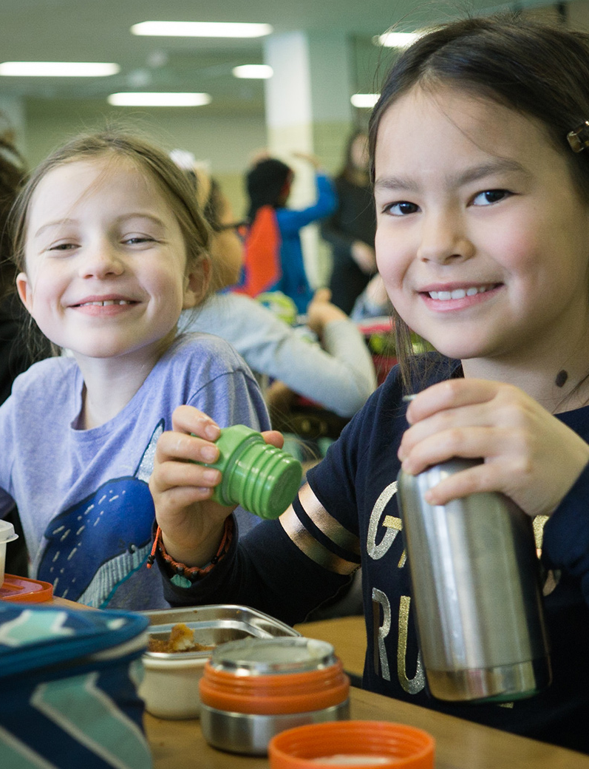
WHY FOCUS ON SCHOOLS?
Research shows a strong link between a young person’s practice of healthy habits, including a good diet and regular physical activity, and an improvement in their overall life outcomes
Notes:
Research also shows that schools can be places for motivating students to lead healthy lifestyles and staff can be role models for showing students how to adopt and maintain healthy behaviors.
Active Living Research reports that after 20 minutes of physical activity, students tested better in reading, spelling and math and were more likely to read above their grade level.
Source: http://activelivingresearch.org/sites/default/files/ALR_Brief_ActiveEducation_Jan2015.pdf
A research brief from the Robert Wood Johnson Foundation found that diabetes and obesity were among the most common causes of school absences. Food security and hunger also contributed to chronic absenteeism.
Source: http://www.rwjf.org/content/dam/farm/reports/issue_briefs/2016/rwjf431726

Slide 8
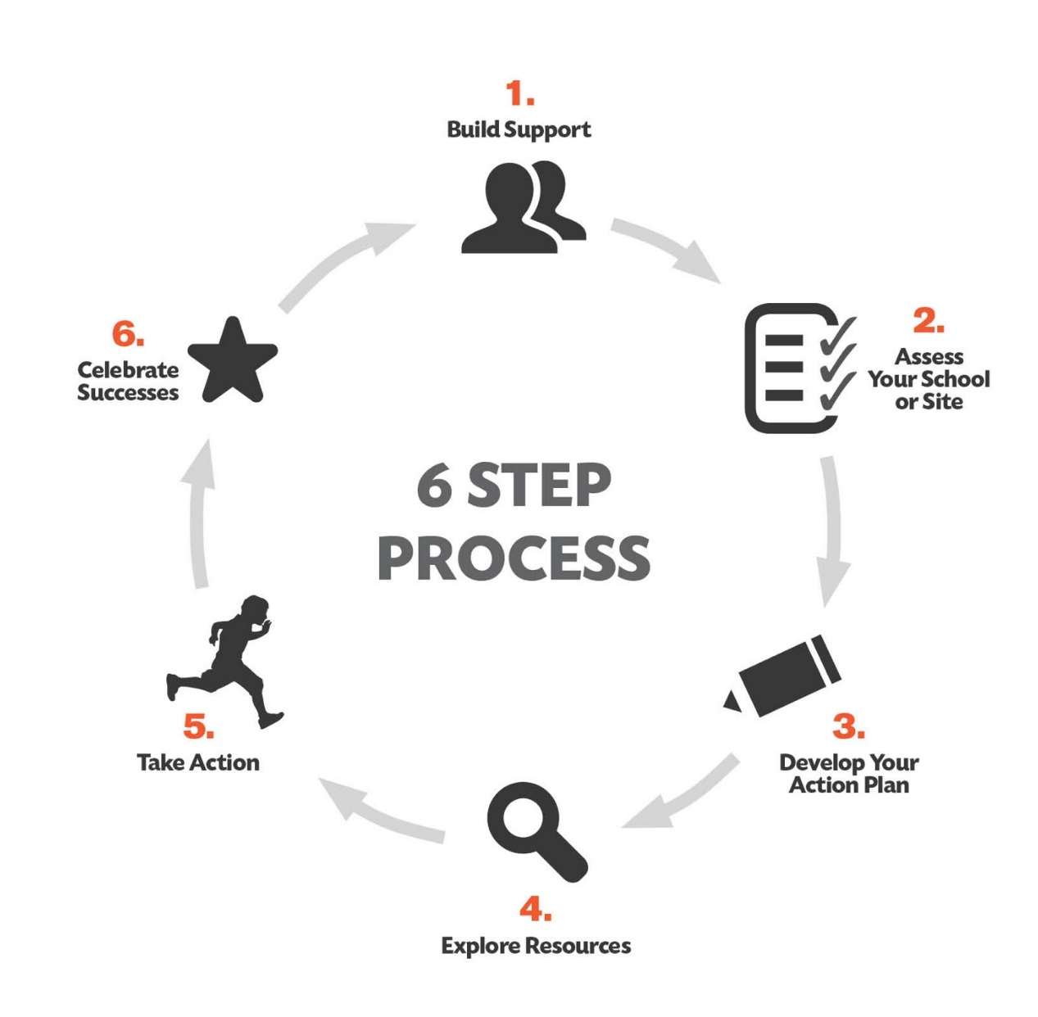
HOW IT WORKS?
Notes:
The Healthy Schools Program has a proven 6-Step Process that guides schools. It’s a circular journey where schools and sites continuously take a status check, work on making improvements, learn from successes and challenges and keep pushing the needle forward. When we repeat the cycle each year, our healthy changes becomes embedded in the culture of the school and efforts to become a healthy environment are sustained.

Slide 9
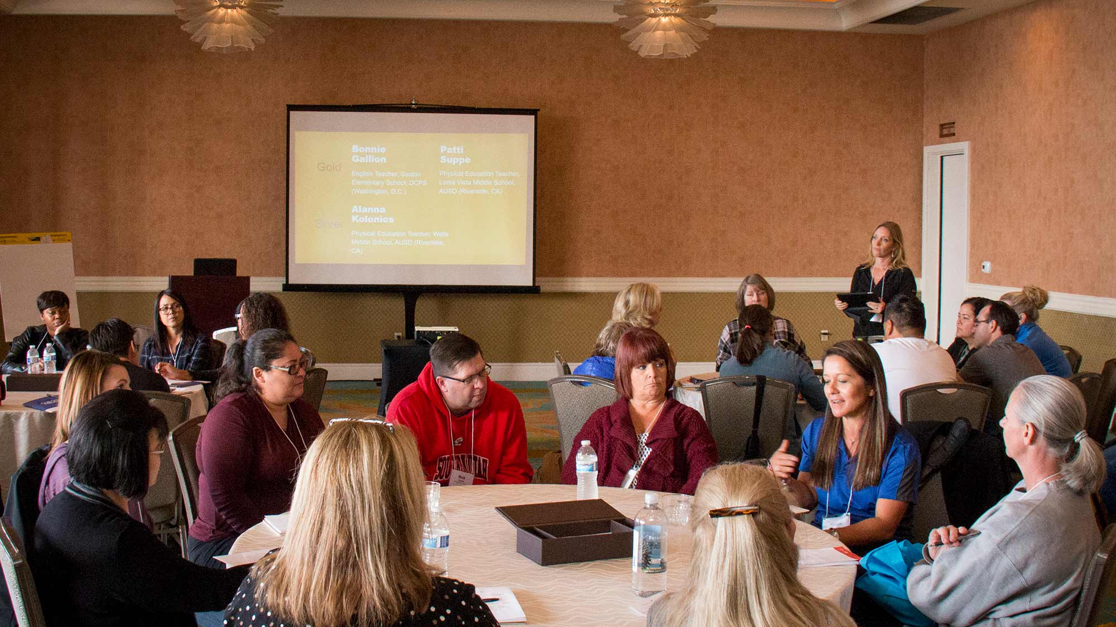






FRAMEWORK OF BEST PRACTICES
POLICY & ENVIRONMENT
NUTRITION SERVICES
SMART SNACKS
HEALTH ED /
PHYSICAL ED
PHYSICAL ACTIVITY
EMPLOYEE WELLNESS
Notes:
Healthier Generation focuses it’s work around evidence-based best practices of a healthy site. We use the Healthy Schools Program Framework of Criteria and Assessment which have been developed by national experts across different organizations including the USDA, the Centers for Disease Control and the School Nutrition Association, that agree “In the ideal world, schools would be doing these things.” The idea is to create a culture where physical activity and good nutrition is the norm, not the exception.
The Healthy Schools Program focuses on 6 Topic Areas:
Policy & Environment
Nutrition Services
Smart Snacks
Health Education / Physical Education
Physical Activity
Employee Wellness
As a school, we decide what we want to focus on and we work to make those small changes year after year. This isn’t an overnight shift but we will begin to see a lot of progress over time.

Slide 10




AMERICA’S HEALTHIEST SCHOOLS
Notes:
We can also work towards becoming one of the Healthiest school’s in America;
The National Healthy Schools Award is a prestigious achievement that celebrates your hard work in creating a healthier school! Schools that receive this award meet best practice criteria established by the Centers for Disease Control and Prevention and outlined in the Healthy Schools Program Framework of Best Practice Criteria.
Healthier Generation helps to promote these award winning schools nationally – so it’s a great opportunity for us to gain a spotlight for all of the work we’re accomplishing!
In the past, award winners have :
Been featured in the annual list of America's Healthiest Schools, which is seen by millions nationwide each year through local and national media, including USA Today, The Huffington Post, Woman's Day, and more.
Received certificate and letters of commendation
Received marketing materials, including large banner for your school

Slide 11

OUR SCHOOL IS CREATING
A HEALTHIER GENERATION
Notes:
Our wellness team is guided by a vision we have for the future of our school:
[Share your school’s wellness vision – it helps others understand where you are starting with wellness and where you hope to go. If you haven’t created a wellness vision with your schools wellness team, you can use this time to talk about some of the ‘healthy’ characteristics, programs or practices you’d like to see your school incorporate over the next 3-5 years. You can give the examples: Become the healthiest school in the district – or – a place where students are proud to be fit.]
We would love your support of this vision and of the goals we’re trying to achieve to get us there.

Slide 12
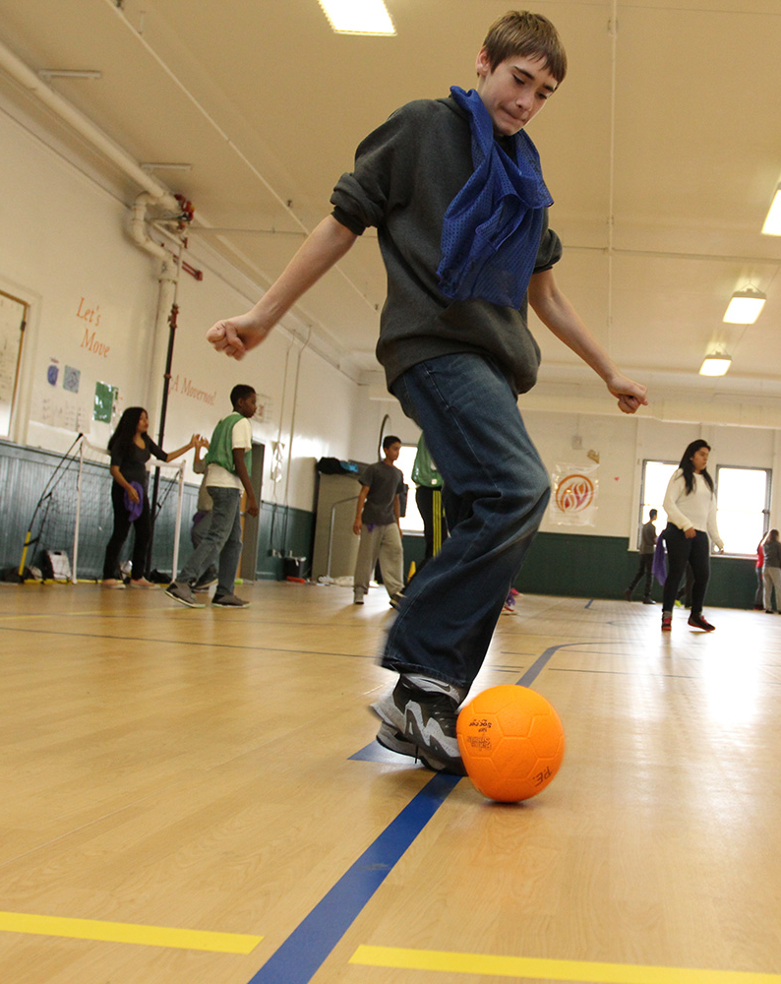
OUR WELLNES GOALS
Our Wellness Goals from the Healthy Schools Program Action Plan:
Notes:
Here are our short term and long term wellness goals that will help us reach our vision of health and wellness for our school.
Instructions for presenting this slide:
If your school has existing Action Plan, use that to guide your conversations (consider adding screenshot or list of your school’s HSP Action Plan). If no AP, talk about what wellness goals this group thinks is important.
Recommend only having 3-5 wellness goals per school year.
When presenting the Action Plan or wellness goals, be mindful of your audience and the support they may be able to offer for each wellness goal.
Example: If presenting to a parent/teacher organization, make sure to solicit feedback and support for all goals but especially around areas that may be of particular interest to them: family and community engagement, healthy fundraising and celebrations.
Before selecting/presenting upon a particular wellness goal, make sure you’ve informed the key individuals who can help put that goal into motion.
Example: If you’ve selected a PE-focused goal, have you worked with the PE staff to get their feedback on feasibility and sustainability of implementing that wellness goal? If not, use this time to discuss and gain their input.
Talk about your timeline and plan for implementing these goals and how this audience can specifically help.

Slide 13
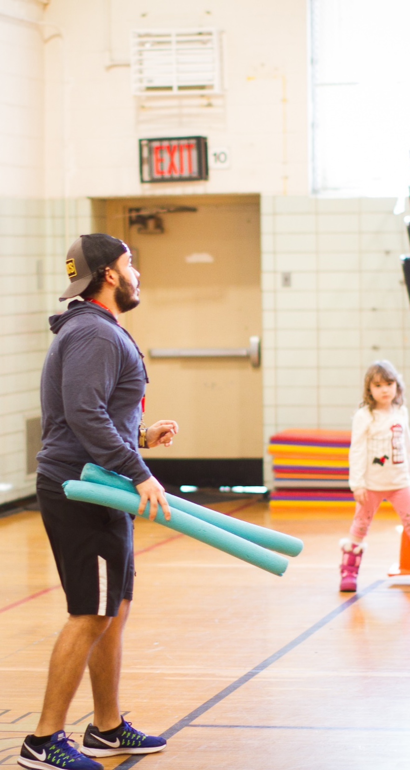
EVERYONE CAN SUPPORT
A HEALTHY FUTURE.
Join our school wellness team
Support/create wellness vision
Integrate healthy best practices
Walk the talk
Educate students & staff about healthy eating,
physical activity and stress reduction
Notes:
[Use this slide when talking with students and school staff]
Here are some ways you can become involved:
Join our school wellness team
Our wellness team meets four times each school year and together we work to inform and implement wellness goals for the school. Our next wellness team meeting is: ________.
If you can’t commit to being wellness team member, there are still plenty of ways you can support the team’s goals throughout the year through ad hoc wellness events or by just being one of our advocates for example, if you can…
Integrate healthy best practices
Into your classrooms/offices. It could be adding in physical activity breaks, offering non-food rewards or integrating health and wellness examples into your curriculums.
Walk the talk
We all know our students watch our behavior so let’s all be positive role models when it comes to health – let’s drink water, move more and make healthier food choices so they can see our healthy habits in practice.
Educate students & staff about healthy eating and physical activity
Let’s all work together to set the tone and expectations of what a healthy school looks like by working together to educate ourselves and others on healthy eating, increased physical activity and stress reduction. The practices and education we put in place today can have long-term results for the students, staff (and maybe even parents) in our school community.

Slide 14
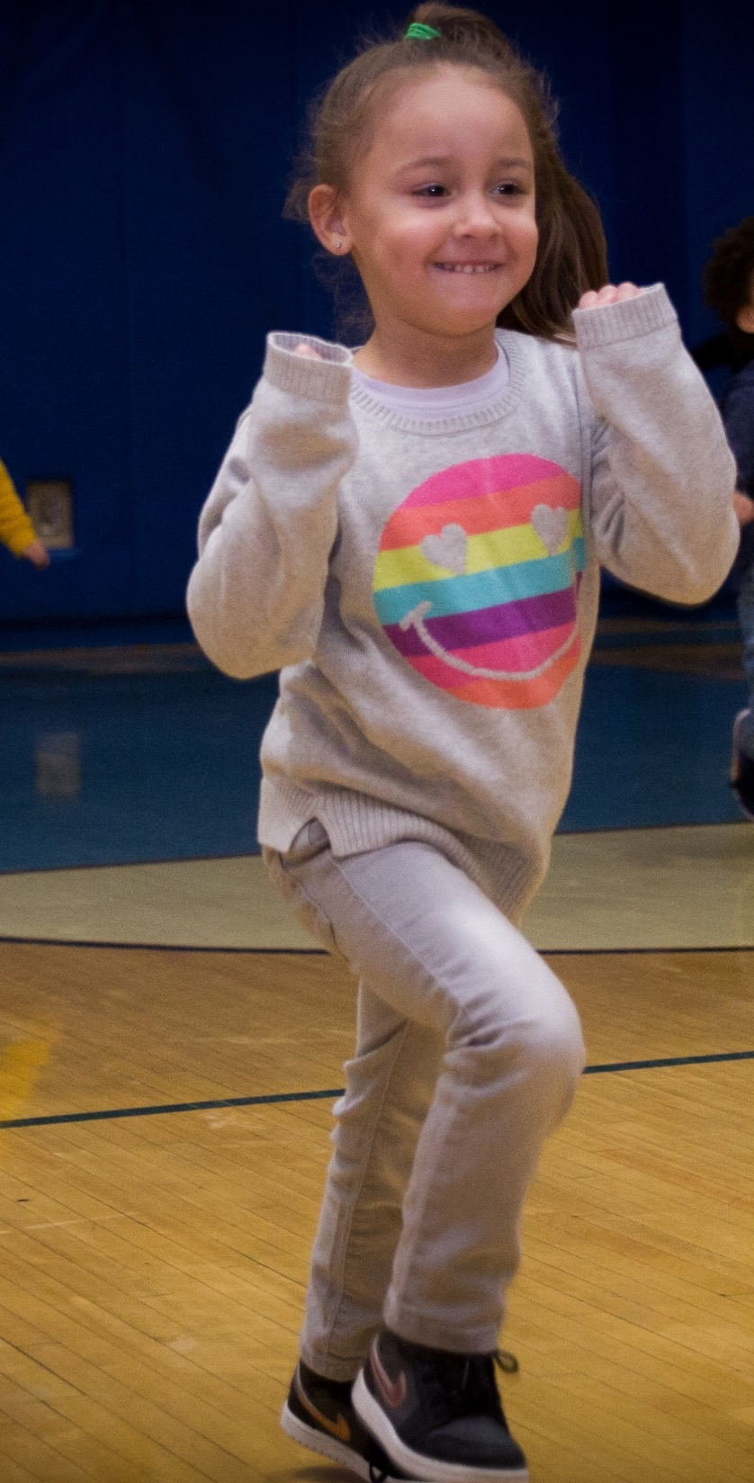
EVERYONE CAN SUPPORT
A HEALTHY FUTURE.
Join our school wellness team
Integrate healthy best practices
Walk the talk
Educate students & staff about healthy eating, physical activity and stress reduction
Notes:
[Use this slide when talking with parents and community members]
Here are some ways you can become involved:
Join our school wellness team
Our wellness team meets four times each school year and together we work to inform and implement wellness goals for the school. Our next wellness team meeting is: ________.
We would like to have (parent/community member) representation
If you can’t commit to being wellness team member, there are still plenty of ways you can support the team’s goals throughout the year through ad hoc wellness events or by just being one of our advocates for example, if you can…
Integrate healthy best practices we’re promoting at school in your home/community
Walk the talk
We all know our students watch our behavior so let’s all be positive role models when it comes to health – let’s drink water, move more and make healthier food choices so they can see our healthy habits in practice.
Educate kids about healthy eating and physical activity
Let’s all work together to set the tone and expectations of what a healthy school, home and community looks like by working together to educate ourselves and others on healthy eating, increased physical activity and stress reduction. The practices and education we put in place today can have long-term results for our entire school community.

Slide 15
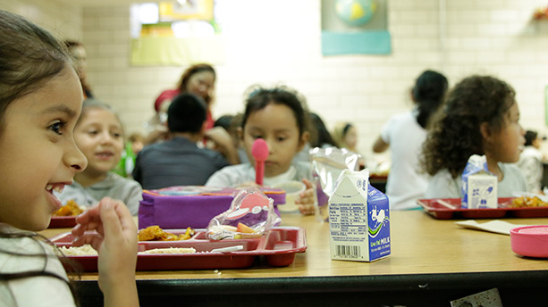
THANK YOU
Questions?
Notes:
I’d like to thank you all for your support and would love to hear any question you might have.

Slide 16
@HealthierGen
/HealthierGeneration
Notes:
Closing slide

